Slide 1
Green University of Bangladesh
Department of Computer Science & Engineering
Subject:Introduction to Electrical Engineering
Course Code: EEE201
My Presentation topic :Electric Motor
Submitted To:
Name : Md.Tariqul Islam
Designation : Lecturer
Department : EEE
Green University of Bangladesh
Submitted by:
Name :Jakirul Islam
ID :193002101
Department: CSE
Green University of Bangladesh

Slide 2
INDEX:
WHAT IS ELECTRIC MOTOR
TYPES OF MOTOR LOADS
CLASSIFICATION OF MOTORS
TYPES OF AC MOTORS
CONCLUSION

Slide 3
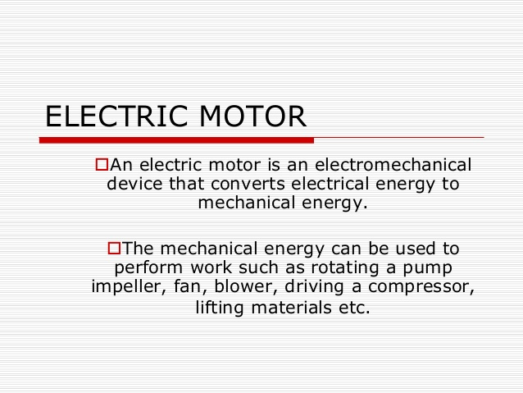

Slide 4
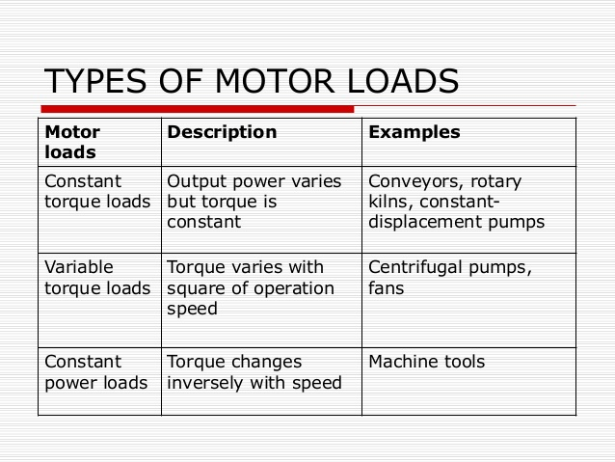

Slide 5
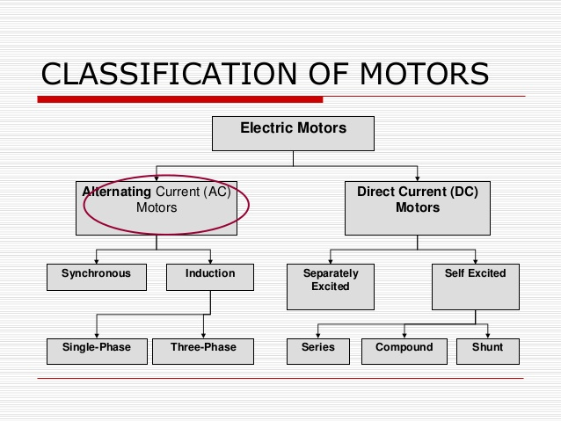

Slide 6
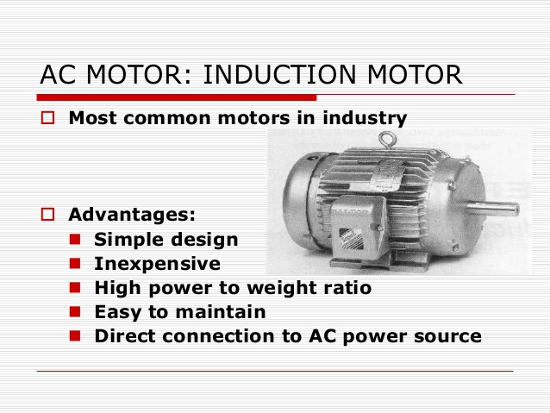

Slide 7
CONCLUSION
In conclusion my hypothesis that the learned that making a simple electric motor isn't all that easy. I learned that in order for the wire to spin the insulation has to be sanded off. I also learned the wire has to be centered with the magnet to help conduct electricity.

Slide 8
Thank You

